Slide 1


ECOLE MICROELECTRONIQUE
CIRCUIT de FRONT-END POUR DETECTEUR A MICRO-PISTES DE SILICIUM EN TECHNOLOGIE CMOS 130nm
Thanh Hung PHAM
Avec la contribution de:
¹A. Savoy Navarro
¹R. Sefri
¹J. F.Genat*
¹J. David
¹M. Dhellot
¹ E. Hornero
*currently on leave of absence at U. Chicago
¹J. F. Huppert
¹A. Charpy
²A. Comerma
³Denis Fourgeron
³Richard Hermel
LPNHE, Universite Pierre et Marie Curie/IN2P3-CNRS
University of Barcelona/Electronics Department
LAPP/IN2P3-CNRS
Ecole Microélectronique, 11-16 oct 2009, La Londe les Maures, Thanh Hung PHAM

Slide 2
Outline
Front-end chip pour silicon strips detector at the ILC
A 4-channel chip in 130nm CMOS
A 88-channel mixed mode chip in 130nm CMOS
Perspective & Conclusion
Ecole Microélectronique, 11-16 oct 2009, La Londe les Maures, Thanh Hung PHAM

Slide 3
The ASIC is designed to work at:
Silicon strips readout at the ILC
The ILC machine cycle imposes the running condition of the detectors/electronics
Long shaping time (slow machine)
Power cycling (possible)
Digitization and pre-processing :
Take advantage of time between inter-bunch trains
200 ms
Ecole Microélectronique, 11-16 oct 2009, La Londe les Maures, Thanh Hung PHAM

Slide 4
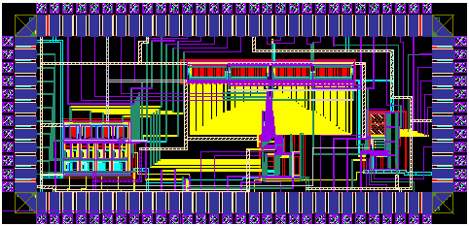
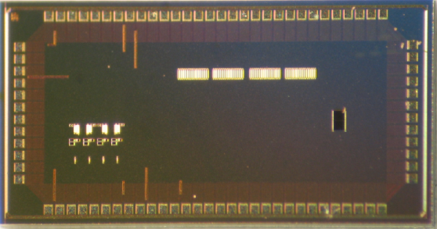
A 4-channel chip in CMOS 130nm
Synopsys of 4-channel chip
Sparsifier
Channel n+1
Σ α_{i}V_{i} > th
Clock 48 MHz
Trigger
Counter
Channel n-1
reset
Ch #
reset
Waveform
Preamp +
Shaper
Analog memory(6MHz)
12-bit single ramp ADC
1.5mm
3mm
130nm chip layout et photo
Ecole Microélectronique, 11-16 oct 2009, La Londe les Maures, Thanh Hung PHAM

Slide 5
A 4-channel chip in CMOS 130nm
Synopsys of analog pipeline
WRITE
READ
INPUT
OUTPUT
RESET
T1
T2
CLK
SHIFT REGISTER 16 bits
Gnd
START
Ecole Microélectronique, 11-16 oct 2009, La Londe les Maures, Thanh Hung PHAM

Slide 6
A 4-channel chip in CMOS 130nm
Synopsys of single ramp ADC
Analogue Input
G
R
A
Y
C
O
U
N
T
E
R
M
U
L
T
I
P
L
E
X
E
R
Latch
Ramp Input
12b
8b
Offset ramp
Offset ramp
Slope ramp
Buffer ramp
Startconv
Clk_48MHz
RST
LH
Ecole de Microélectronique, 11-16 oct 2009, La Londe les Maures, Thanh Hung PHAM

Slide 7
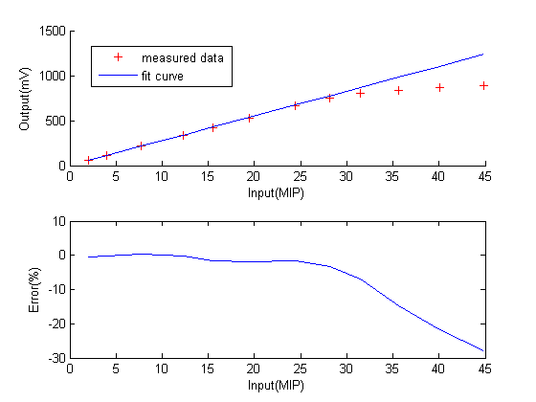
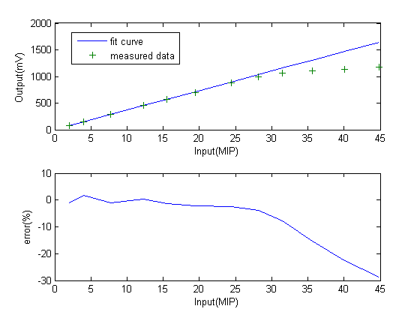
A 4-channel chip in CMOS 130nm
Preamplifier & Pulse shape simulation
ENC@0.8μs = 733.7 + 14.63 electrons/pF
ENC@2μs = 613 + 9 electrons/pF
Ecole de Microélectronique, 11-16 oct 2009, La Londe les Maures, Thanh Hung PHAM

Slide 8
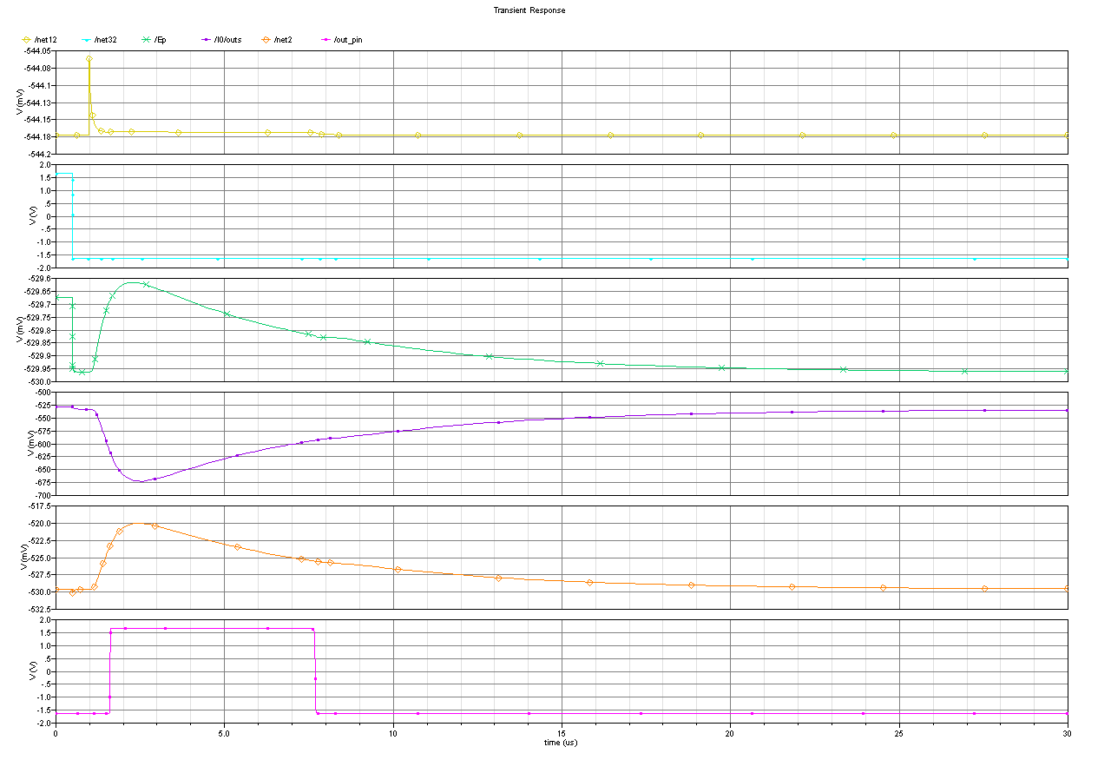
Simulation of sparsifier (1/2)
Input
DC sampling
Positive input of inv-adder
Adder-inverter output
Shaper output
Sparsifier output
t_{delay}
Time (ns)

Slide 9
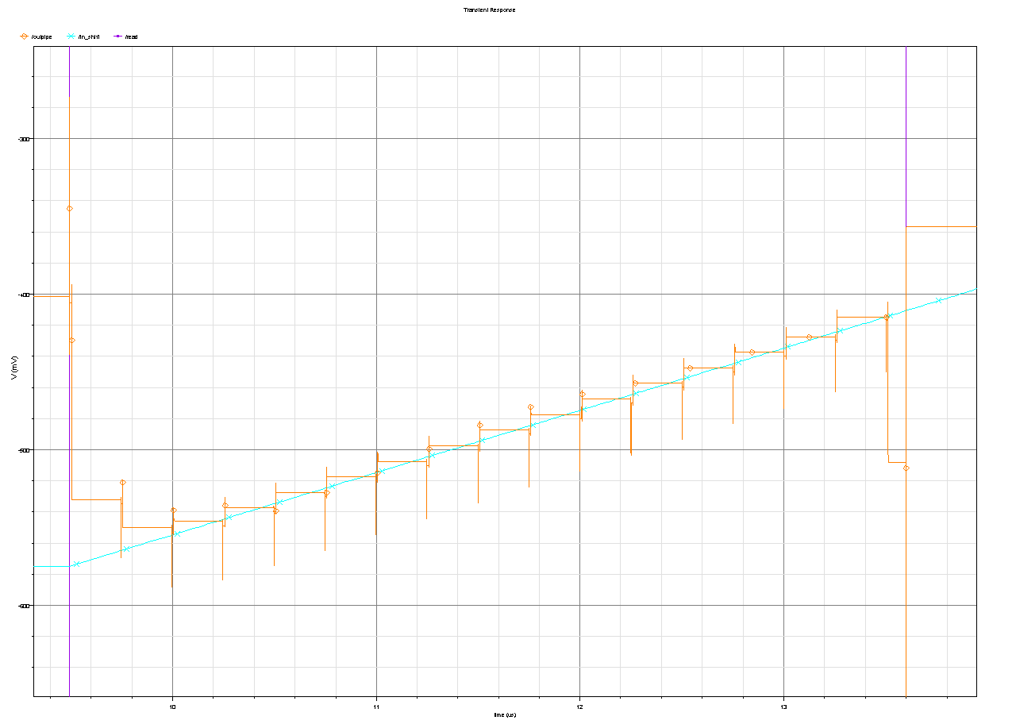
A 4-channel chip in CMOS 130nm
Analog pipeline simulation
Analog pipeline
No of sample | 1 | 2 | 3 | 4 | 5 | 6 | 7 | 8 | 9 | 10 | 11 | 12 | 13 | 14 | 15 | 16
Voltage difference(mV) | 33 | 4.83 | -1.1 | -2.3 | -2.3 | -2.4 | -2.6 | -2.5 | -2.4 | -2.6 | -2.6 | -2.6 | -2.5 | -2.5 | -2.5 | 0.2
V(mV)
-300
-400
Ramp reconstructed with analog pipeline
-500
-600
Input ramp of pipeline
10
11
12
9
Time (μs)
Ecole de Microélectronique, 11-16 oct 2009, La Londe les Maures, Thanh Hung PHAM

Slide 10
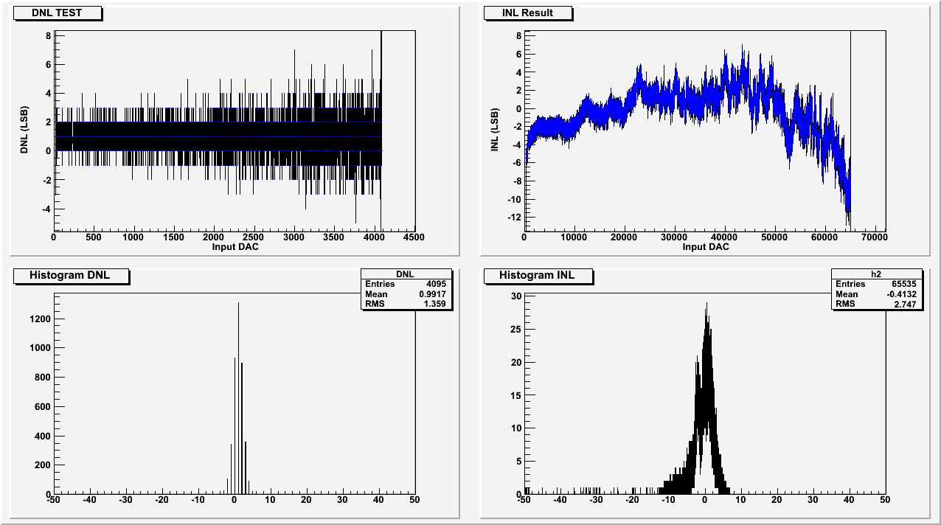
A 4-channel chip in CMOS 130nm
ADC Measurements
DNLmax = 7LSB
INLmax = 7LSB
INLrms = 2.74LSB
DNLrms = 1.36LSB
10
Ecole Microélectronique, 11-16 oct 2009, La Londe les Maures, Thanh Hung PHAM

Slide 11
A 4-channel chip in CMOS 130nm
Analog pipeline measurement
Input = 50mV
Sampling rate = 6MHz
Calibration capacitance = 256fF
Non uniformity of gain due to non-uniformity of calibration capacitor
Ecole Microélectronique, 11-16 oct 2009, La Londe les Maures, Thanh Hung PHAM

Slide 12
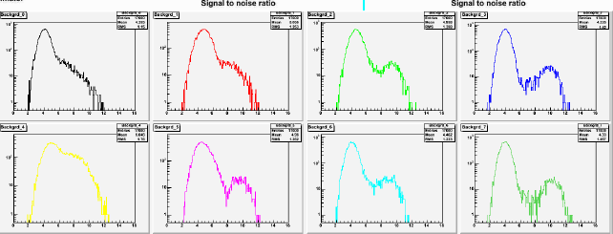
Measurement with sensor
Response to Sr90
A 4-channel chip in CMOS 130nm
HPK sensor
Average S/N about 15 (2x9.15cm=18.3 cm strip length)
Ecole Microélectronique, 11-16 oct 2009, La Londe les Maures, Thanh Hung PHAM

Slide 13
A 88-channel chip in CMOS 130nm
Synopsys of 88-channel chip
Channel#i
ADC REGISTER,
GRAY COUNTER
MULTIPLEXER &
OUTPUT INTERFACE
Preamplifier + CR-RC Shaper
ADC
input_{i}
0
Latch
Sparsifier
i-1
7
i
Ramp
ref_{i}
0
7
Calibration
i+1
8x8 analog memories
Bias generator:
Bias voltage (10bits), bias current (8bits), reference voltage (10bits)‏
Main control : pipeline, time stamp, event stamp, calibration, A/D conversion
Input interface, Initial Setup
Ecole Microélectronique, 11-16 oct 2009, La Londe les Maures, Thanh Hung PHAM

Slide 14
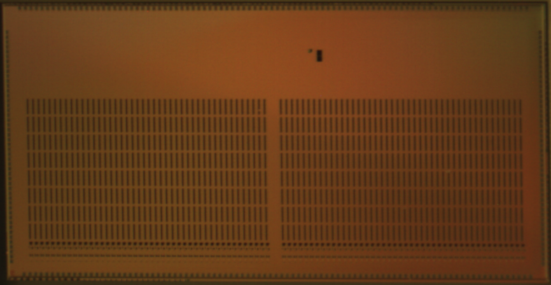
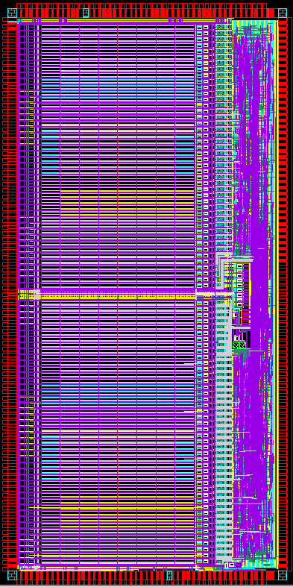
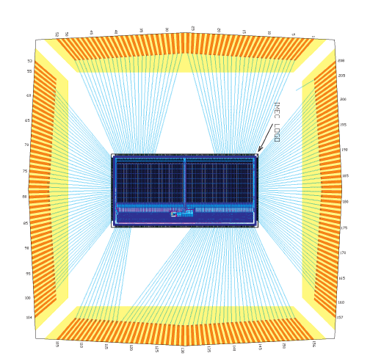
A 88-channel chip in CMOS 130nm
Layout and silicon die of a 88-channel chip
5mm
Analogue
Digital
Bias control
10mm
Picture of the silicon die
Bonding diagram of the packaged chip
Layout
Ecole Microélectronique, 11-16 oct 2009, La Londe les Maures, Thanh Hung PHAM

Slide 15
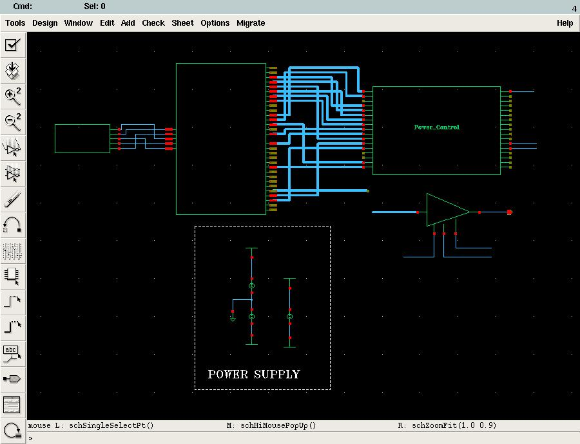
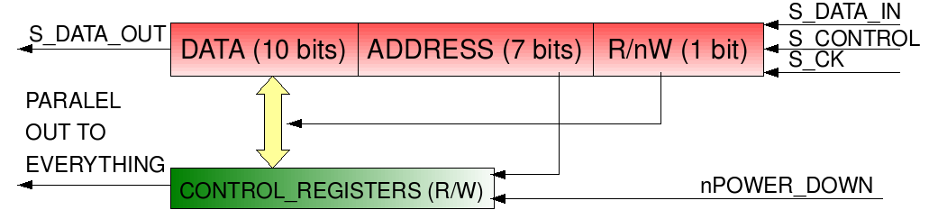
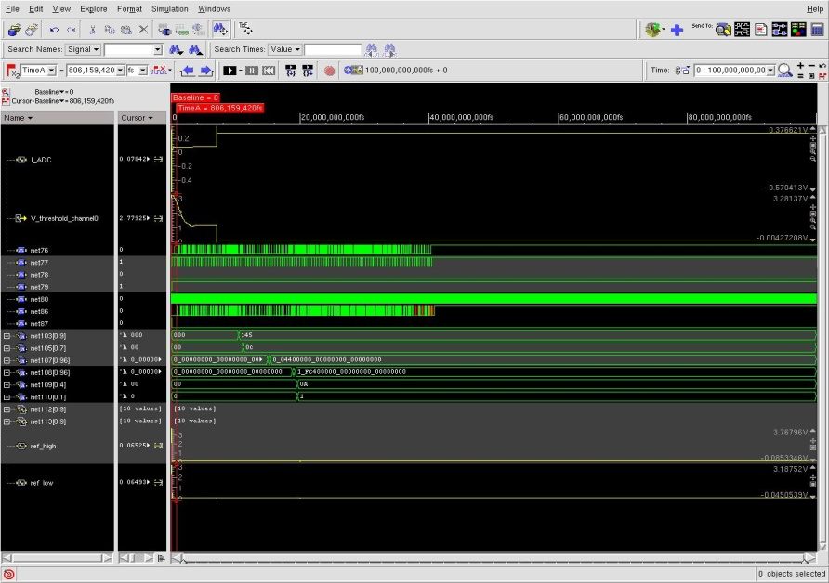
A 88-channel chip in CMOS 130nm
Initialization & Input Interface
Analog bias (DAC)
98x10-bit registers
Serial input(48Mhz clock)
Channel threshold simulation
(Mixed-mode simulation)
Ecole Microélectronique, 11-16 oct 2009, La Londe les Maures, Thanh Hung PHAM

Slide 16
A 88-channel chip in CMOS 130nm
Write state
Ecole
Microélectronique, 11-16 oct 2009, La Londe les Maures, Thanh Hung PHAM

Slide 17
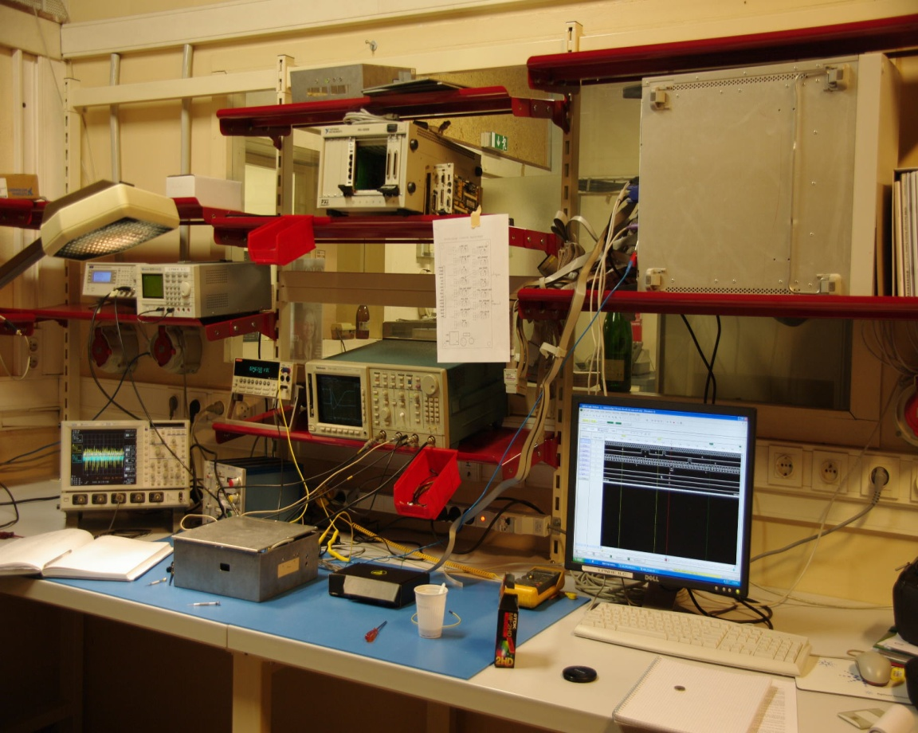
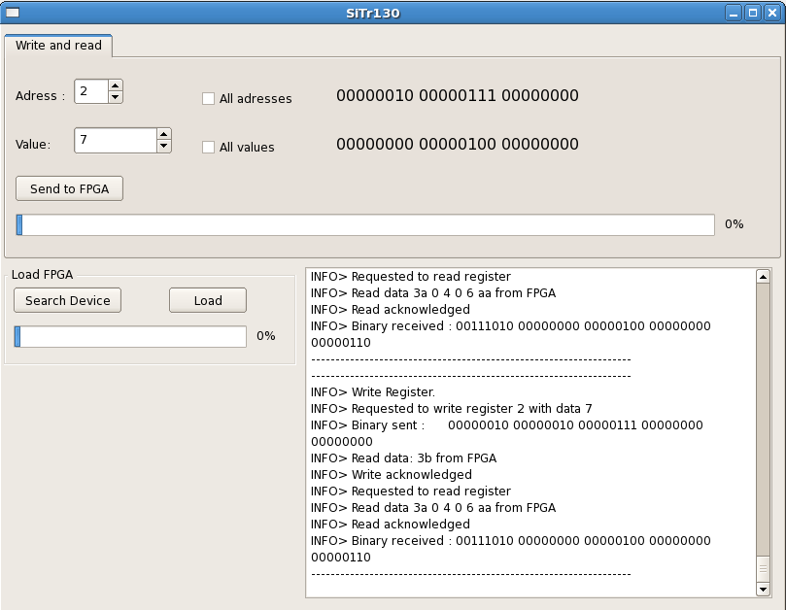
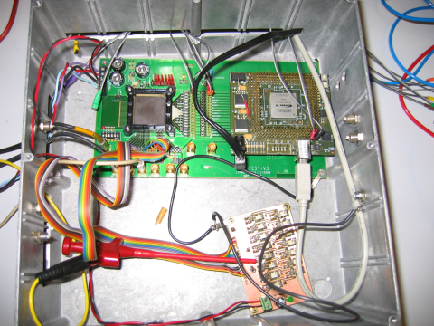
A 88-channel chip in CMOS 130nm
Lab test bench
Logic analyzer
Oscilloscope
SiTR_130-88 + FPGA in metalic box
PC and C++ based program allows the control of the circuit
USB link
Ecole Microélectronique, 11-16 oct 2009, La Londe les Maures, Thanh Hung PHAM

Slide 18
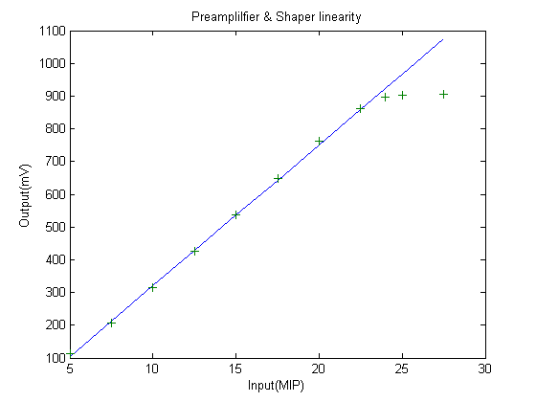
A 88-channel chip in CMOS 130nm
Test of the analogue part
Measured power dissipation per ch (wrt all the analog chain up and including the ADC):
~1.35mW/channel
Measured gain ~ 43mV/MIP
@ 2.6% of nonlinearity up to 24MIP
Linearity of the preamplifier and the shaper
Ecole Microélectronique, 11-16 oct 2009, La Londe les Maures, Thanh Hung PHAM

Slide 19
Conclusion & Perspective
A first front-end chip has been designed and tested that allows to validate the choice of technology and architecture.
A second front-end chip with 88 channel was not fully tested but introduce us to a complex circuit.
A new 128-channel chip is under development with an optimization in silicon surface by using 2f Mimcaps capacitor .
Direct connection to detector is under investigated
Ecole Microélectronique, 11-16 oct 2009, La Londe les Maures, Thanh Hung PHAM

